Slide 1
The Chef
Restaurant Web Project

Slide 2
Home Page
HTML of Home page is located in Home.html.
It contains a background image added using CSS class on body tag.
On the top of the website, a Navbar is created by using a div containing 5 hyperlinks.
First hyperlink is Nav-Brand made by using logo inside it, using img tag. On clicking this Home page reloads if we are on home page.

Slide 3
Home Page
Second hyperlink is Home and disabled because we are currently on the home page. If we will on any other page then it won’t disable and by clicking it we can render home page.
Third hyperlink is Menu by clicking it we can render menu page.
Fourth hyperlink is Place Order by clicking it we can render place order page.
Fifth hyperlink is Login by clicking it we can render to login page. If user is logged in it shows user image in a hyperlink instead of Login hyperlink as shown below. If we click that image use logged out and Login hyperlink appeared again.

Slide 4
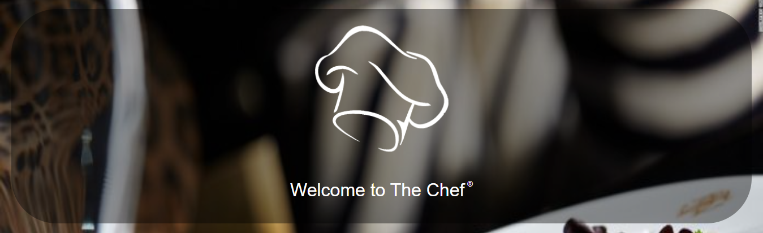
Home pAGE
Under Navbar, there’s main content of home page which contain a div containing website logo and welcome message shown in image below:

Slide 5
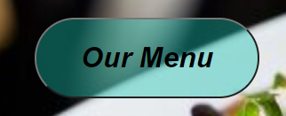
Home Page
Under this, there’s a hyperlink containing a button made using button tag. By clicking it, nenu page is rendered.
In the end of page there’s a footer, which will remain same in all up coming pages. It contains a div containing two hr tags and a div between them containing three divs containing hyperlinks of all pages in left, a logo and copyrights statement in between and the address and contact at right.

Slide 6
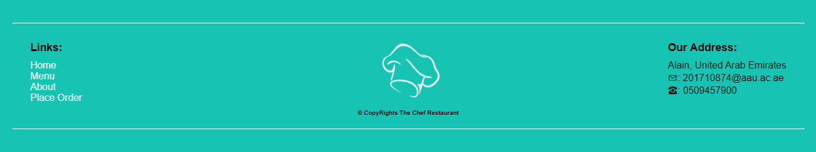
Home Page
By clicking hyperlinks we can render same pages as mention above for hyperlinks in Navbar.
Image of Footer is shown below:

Slide 7
Menu Page
HTML of Menu page is located in Menu.html.
On the top of the website, a Navbar is created by using a div containing 5 hyperlinks.
First hyperlink is Nav-Brand made by using logo inside it, using img tag. On clicking this Home page renders.

Slide 8
Menu Page
Second hyperlink is Home by clicking it we can render home page.
Third hyperlink is Menu and disabled because we are currently on the menu page. If we will on any other page then it won’t disable and by clicking it we can render menu page.
Fourth hyperlink is Place Order by clicking it we can render place order page.
Fifth hyperlink is Login by clicking it we can render to login page. If user is logged in it shows user image in a hyperlink instead of Login hyperlink as shown below. If we click that image use logged out and Login hyperlink appeared again.

Slide 9
MENU PAGE
Below Navbar, there’s an image acting like carousal, made by a hyperlink containing img tag which is rendering the Place Order page.
Below this, there are several Cards.
Each card is made of a div having two divs first div with img tag showing image of dish and the other contains dish title, pill(maybe), price-tag, categories and an order button rendering to Place Order page. One of them is shown below:

Slide 10
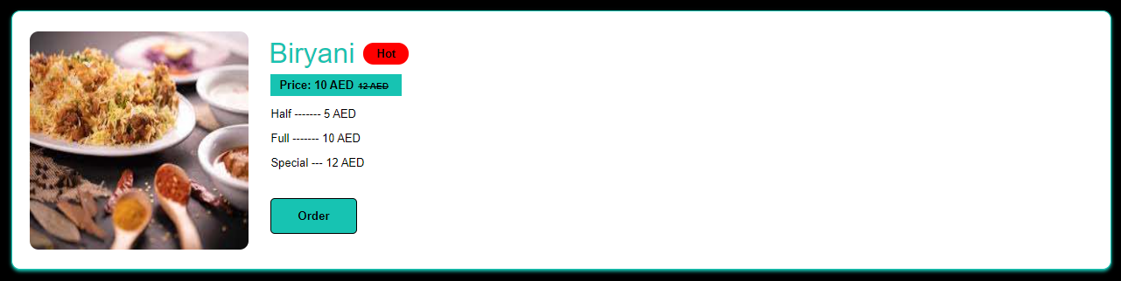
Menu page
In the end of page there’s a footer as mentioned above in Home page portion. Footer is same for all pages.

Slide 11
Place Order Page
HTML of Place Order page is located in OrderForm.html.
On the top of the website, a Navbar is created by using a div containing 5 hyperlinks.
First hyperlink is Nav-Brand made by using logo inside it, using img tag. On clicking this Home page renders.

Slide 12
Place Order Page
Second hyperlink is Home by clicking it we can render home page.
Third hyperlink is Menu by clicking it we can render menu page.
Fourth hyperlink is Place Order and disabled because we are currently on the Place Order page. If we will on any other page then it won’t disable and by clicking it we can render Place Order page.
Fifth hyperlink is Login by clicking it we can render to login page. If user is logged in it shows user image in a hyperlink instead of Login hyperlink as shown below. If we click that image use logged out and Login hyperlink appeared again.

Slide 13
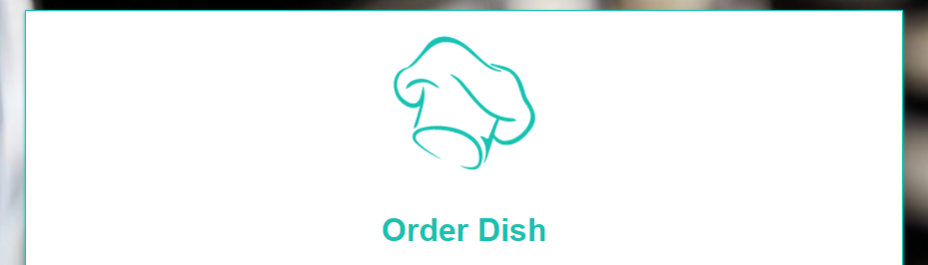
Place Order Page
Under Navbar, there’s a Form, having logo logo is created using img tag and form page name on the top.

Slide 14
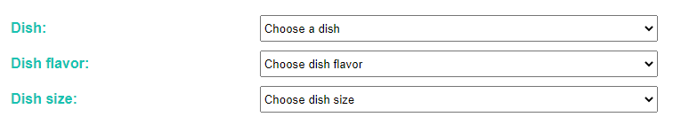
Place Order Page
Then in the same Form there are 3 Select tags those are used for dishes, flavor and size choice respectively.
After this there is a Input field for type text and after that a Textarea for Extras, shown below:

Slide 15
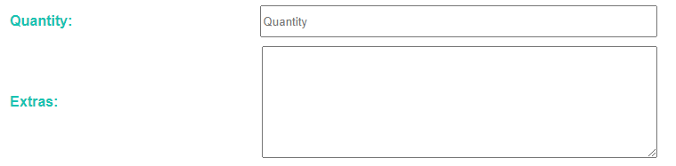
Place Order Page
If user is not login then there are two extra Input fields one is for type email and one is for tel used for email and phone no respectively.
Then there is another Textarea for Address shown below:

Slide 16

Place Order Page
In the end of Form there is a Input button of type submit, which render the Home page if pressed.
In the end of page there’s a footer as mentioned above in Home page portion. Footer is same for all pages.

Slide 17
Login pAGE
HTML of Login page is located in LoginForm.html.
On the top of the website, a Navbar is created by using a div containing 5 hyperlinks.
First hyperlink is Nav-Brand made by using logo inside it, using img tag. On clicking this Home page renders.

Slide 18
Login Page
Second hyperlink is Home by clicking it we can render home page.
Third hyperlink is Menu by clicking it we can render menu page.
Fourth hyperlink is Place Order by clicking it we can render place order page.
Fifth hyperlink is Signup by clicking it we can render to Signup page.
Under Navbar, there’s a Form, having logo logo is created using img tag and form page name on the top shown below:

Slide 19

Login page
Then there are two Input fields one is for type email and one is for password used for email and password respectively shown below:

Slide 20
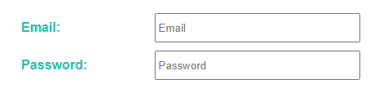

Login Page
Then there is a hyperlink by clicking it signup page rendered.

Slide 21

Login Page
In the end of Form there is a Input button of type submit, which render the Home page if pressed but as user is logged in. Button is showned below:
In the end of page there’s a footer as mentioned above in Home page portion. Footer is same for all pages.

Slide 22
SignUP Page
HTML of Login page is located in SignupForm.html.
On the top of the website, a Navbar is created by using a div containing 5 hyperlinks.
First hyperlink is Nav-Brand made by using logo inside it, using img tag. On clicking this Home page renders.

Slide 23
Signup pAGE
Second hyperlink is Home by clicking it we can render home page.
Third hyperlink is Menu by clicking it we can render menu page.
Fourth hyperlink is Place Order by clicking it we can render place order page.
Fifth hyperlink is Login by clicking it we can render to login page.
Under Navbar, there’s a Form, having logo logo is created using img tag and form page name on the top shown below:

Slide 24
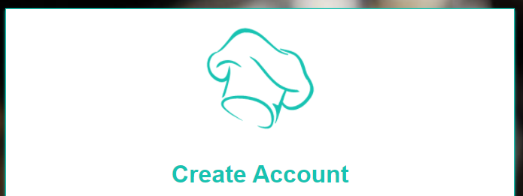
Signup pAGE
Then there are 4 Input fields two are for type text, one is for type email and one is for password used for first name, last name email and password respectively shown below:

Slide 25
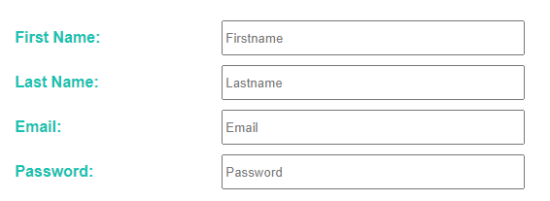
Signup Page
Then there is a hyperlink by clicking it login page rendered as shown below:

Slide 26


Signup page
In the end of Form there is a Input button of type submit, which render the Home page if pressed but as user is logged in. Button is showned below:
In the end of page there’s a footer as mentioned above in Home page portion. Footer is same for all pages.

Slide 27
The End

